Slide 1
Majlis Ansārullāh Monthly Meeting
October 2021
This slide deck contains images licensed for the purpose of this presentation only.
No one is permitted to use the images for any other use, without prior permission.

Slide 2
Agenda
Recitation of the Holy Quran
Pledge
Salat page
The Holy Quran segment (10 min)
- Selected verses
- Questions and comments
Friday Sermon segment (20 min)
-Sermon synopsis
-Discussion scenario and guidance from sermon
-Take home message
Mental and physical health segment (15 min)
Open slot for local topics
Reminders/announcements
Dua

Slide 3
Recitation of Holy Quran
Nay, whoever submits himself completely to Allah, and is the doer of good, shall have his reward with his Lord. No fear shall come upon such, neither shall they grieve. (2:113)
And who is better in faith than he who submits himself to Allah, and he is a doer of good, and follows the religion of Abraham, the upright? And Allah took Abraham for a special friend. (4:126)

Slide 4
Ansar Pledge
Say this part three times:
Ash-hadu • alla ilaha • illallahu • wahdahu • la sharika lahu • wa ash-hadu • anna Muhammadan • ‘abduhu • wa rasuluh
Say this part once:
I bear witness • that there is none worthy of worship • except Allah. • He is One • (and) has no partner, • and I bear witness • that Muhammad (peace be upon him) • is His servant • and messenger.
Say this part once:
I solemnly pledge • that I shall endeavor • throughout my life • for the propagation • and consolidation • of Ahmadiyyat in Islam, • and shall stand guard • in defense of • the institution of Khilafat. • I shall not hesitate • to offer any sacrifice • in this regard. • Moreover, • I shall exhort my children • to always remain dedicated • and devoted • to Khilafat. • Insha’allah.

Slide 5
Salat Page
The Messenger of Allah (peace be upon him and his progeny) has said: “The prayer of a person is (in reality) a light in his heart, so whoever desires, can illuminate his heart (by means of prayers).”
Kanzul `Ummal, Volume7, Tradition 18973

Slide 6
The Holy Quran Segment
Suggested Time = 10 mins
It contains verses, questions
about the verses followed
by commentary

Slide 7
Recitation of Holy Quran
Nay, whoever submits himself completely to Allah, and is the doer of good, shall have his reward with his Lord. No fear shall come upon such, neither shall they grieve. (2:113)
And who is better in faith than he who submits himself to Allah, and he is a doer of good, and follows the religion of Abraham, the upright? And Allah took Abraham for a special friend. (4:126)

Slide 8
Questions
Virtuous people who submit to the will of Allah are often tried and go through trials. Why does the verse say, “No fear shall come upon such, neither shall they grieve”?
Why does Allah the Almighty quote the example of Abraham in the verse 4:126?

Slide 9
Commentary
When one reaches the highest stage of union. In this stage man is so sure of the existence of God that he may be said to be actually seeing Him. No fear of the future darkens his faith, and the present has no sorrow for him. This stage is called “Liqa” or union with God.
Abraham (as) has been held out to the people of the Book who revere him as a patriarch and to the Arabs who were proud of being descendent from him as an example who embodied in his person the essence of Islam by his full submission to the will of God; and both these people are herein told that it is only the true observance of the teachings of Islam that can make one like Abraham – beloved of God and his special friend (Five volume commentary)

Slide 10
Friday Sermon Segment
Suggested Time = 20 mins
It contains the following items:
Synopsis of Friday Sermon (2 slides)
Scenario discussion and discussion questions (2 slides)
Guidance from Sermon to close the discussion (1 slide)
Take home message from the Sermon (1 slide)

Slide 11
Hold your faith dearer than your life Friday Sermon Frankfurt Germany: August 29, 2003
Friday Sermon

Slide 12
Eighth condition of Bai’at
That he/she shall hold faith, the honor of faith and the cause of Islam dearer than his/her life, wealth, honor, children, and all loved ones.

Slide 13
Synopsis of the Sermon
The pledge to prefer faith over the world is a pledge that everyone who is constantly linked with the Jama‘at and attends meetings and ijtima‘at repeats over and over again.
One should be completely obedient and should follow the commands of Allah with all his strengths. He should dedicate himself to faith and be gracious. One should not fear that his wealth or children would be wasted. Allah, Who is better than anyone else in returning favors and in rewarding efforts, will reward these actions Himself. As has been explained earlier, He Himself will protect his life, wealth, and honor. Allah the Almighty does not let such people, or their future generations go to waste.
Whoever devotes all his faculties to the path of God, and whoever is actively doing truly righteous deeds with his words, conduct, movements, standing, and his entire life is purely for the sake of God, will have a special reward. God will deliver him from fear and grief.
“Revival of Islam demands a ransom from us. What is it? It is us dying in this very path. This is the death upon which the life of Islam, the life of Muslims, and the manifestation of the Living God depend.” (The Promised Messiah (as)

Slide 14
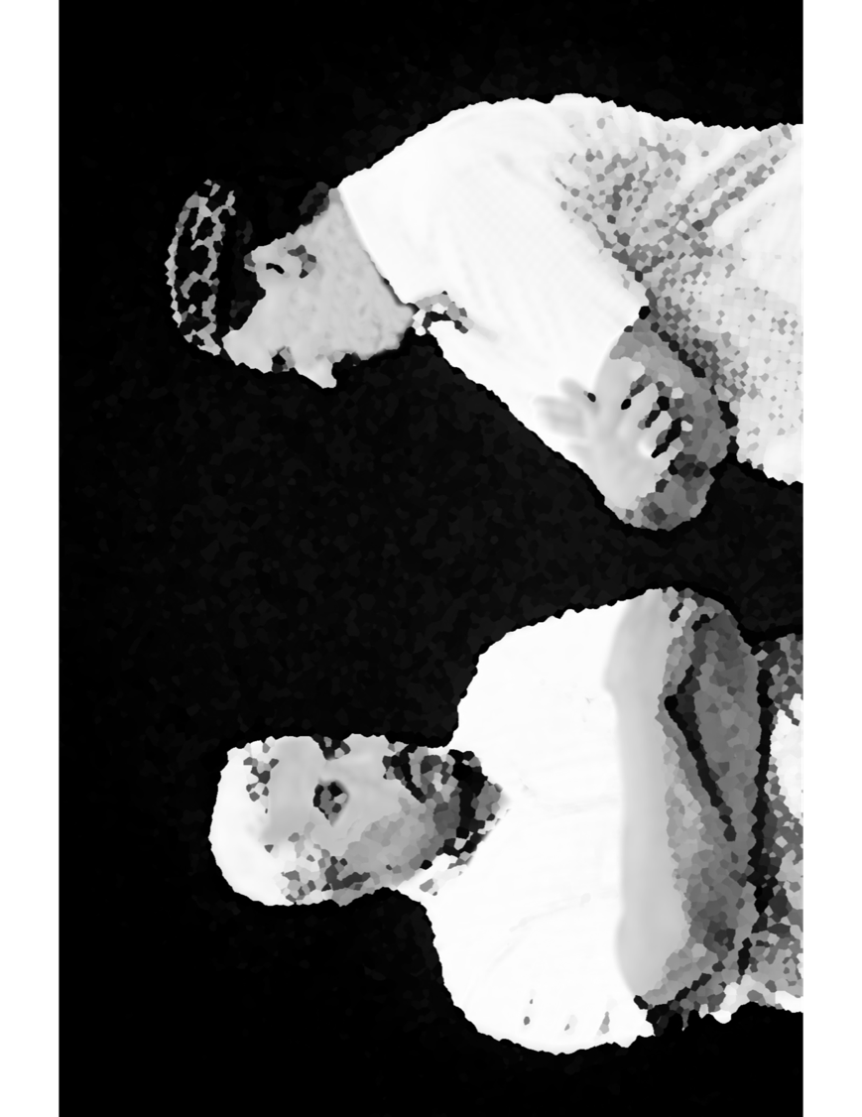
Discussion Scenario
Za’im sahib approached a Nasir about paying Tehrike Jadid Chanda. The Nasir has school going children. He opened up with Za’im sahib. Jama’at Chanda, Ansar Chanda, Tehrike Jadid, Waqfe Jadid, Mosque fund etc. If I keep paying for these, how would I save any money for the education of my children. Afterall, education is important and successful children will benefit the Jama’at. I have to save for them and if something is left, I will pay towards the various schemes.
Za’im sahib mentioned, if you pay for these causes, Allah will provide for your needs.

Slide 15
Discussion
In your opinion,
The Nasir is correct, taking care of our children is huge responsibility and their education is of prime importance. He can pay for voluntary Chandas after he has saved for their education.
The Za’im sahib is correct, the Nasir should pay whole heartedly and leave the rest to Allah the Almighty.
They are both correct. The Nasir can pay Jama’at Chanda, save for his children’s education and pay for other financial schemes if possible
Any other suggestion?

Slide 16
Guidance from the Sermon
“One should be completely obedient and should follow the commands of Allah with all his strengths. He should dedicate himself to faith and be gracious. One should not fear that his wealth or children would be wasted. Allah, Who is better than anyone else in returning favors and in rewarding efforts, will reward these actions Himself. As has been explained earlier, He Himself will protect his life, wealth, and honor. Allah the Almighty does not let such people, or their future generations go to waste”
Bottom line is that Allah the Almighty watches our for those who sacrifice for Him. The Nasir can sacrifice based on his capacity and have trust in Allah to meet his needs in life

Slide 17
Take "home" message?
Pick one of the following topics from this Friday sermon to discuss with children/family during casual discussion:
As a family, share stories of how Allah the Almighty helped each one of you in times of need?
Discuss as to how giving precedence to faith over worldly matters applies to our lives and where we can do better?
Tips to engage youth in conversation: (1) Give them more talking time, and (2) use examples from Huzur’s (may Allah be his helper) sermon to make a point.

Slide 18
Mental and Physical health Segment
Suggested Time = 15 mins
It contains questions of
general knowledge and/or
religious knowledge
followed by their answers.
A thought-provoking video and a physical health segment

Slide 19
Mental Health

Slide 20
Quiz
Give a few examples how to be environmentally friendly?
Which are the longest and shortest bones in human body?
Which Ahmadi Khalifa had an attack on his life and when?

Slide 21
1. Learn about global warming, save power, avoid wasting water, avoid wastage of food, eat more meat free meals, consume less energy and use renewable if possible. 2. Femur (thigh bone) is the longest bone about 18-19 inches and Stapes (in the inner ear) is the smallest about 3-4 mm.
3.On March 10, 1954 Hadhrat Kalifatul Masih II (ra) was attacked by a misguided person as he was leading Asr prayers. This resulted in a severe injury to his neck which took a long time to heal.
Answers

Slide 22
Wonders of creation of Allah the Almighty
Power of 90,000 PSI of Water. Allah
the Almighty has stored a lot of
energy in water. We can use it to our
benefit.
From “Learn something”

Slide 23
Physical Health

Slide 24
Care of your elders
Our elders face health, physical and social stressors that are unique to immigrant cultures
Social Isolation, language barrier, inability to move with freedom, financial stressors, access to culturally congruent health care, lack of integration are to name a few challenges
Elderly are at high risk of depression and other mental illness
Physical illness, disability, falls and cognitive impairment can be devastating to this vulnerable group

Slide 25
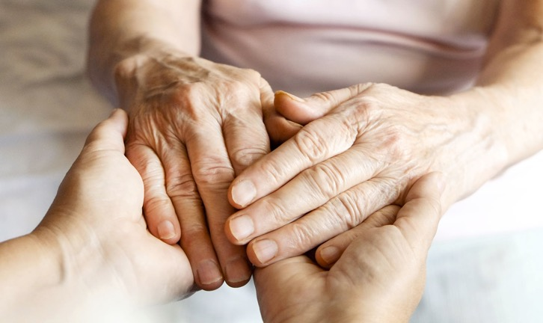
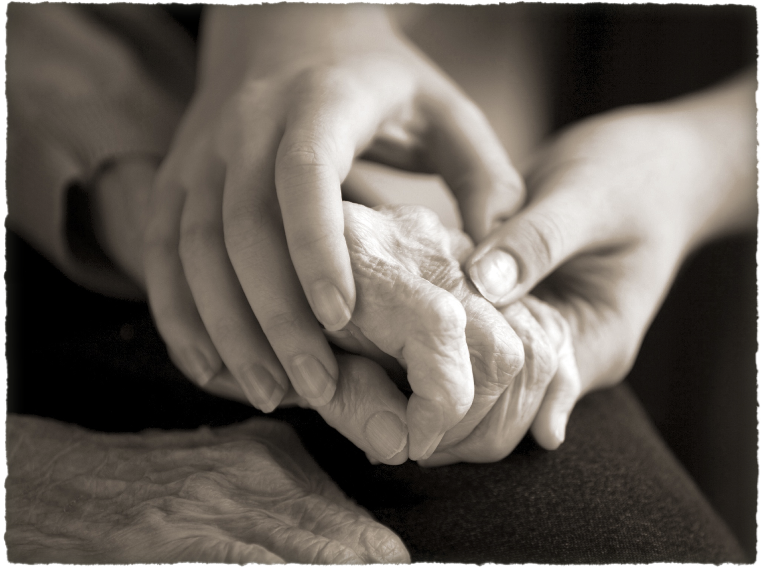
Care of your elders
The greatest care is respect, love, kindness and compassion
Treatment of BOTH physical and mental ailments
Use of all available resources, medical, psychological and social
Preventive Care - Fall, Cancers etc.
Estate and Will planning
Advance Directives, Living Will for health care and finances

Slide 26
Open Segment
Suggested Time = Zaim’s discretion
Zaim can include any other segment of local interest in this segment

Slide 27
That’s all folks
Reminders/Announcements
Dua
Jazakumullah for Participating!
If you enjoyed it, please convey to those brothers who are not here today!

