Slide 1
Majlis Ansārullāh Monthly Meeting
January 2022
This slide deck contains images licensed for the purpose of this presentation only.
No one is permitted to use the images for any other use, without prior permission.

Slide 2
Agenda
Recitation of the Holy Quran (5 mins)
Pledge
The Holy Quran segment (10 min)
Khalifa’s guidance segment: Based on Huzoor’s address in the final
session of UK Ansarullah Ijtema, 9/12/21 (20 min)
Domestic responsibility segment (10 mins)
Salat (Daily Prayers) Segment (5 mins)
Health segment (10 min)
Technology segment (5 mins)
Open slot for local topics (10-20 mins)
Reminders/announcements (5 mins)
Du'a
Suggested Total Time (75 – 90 mins)

Slide 3
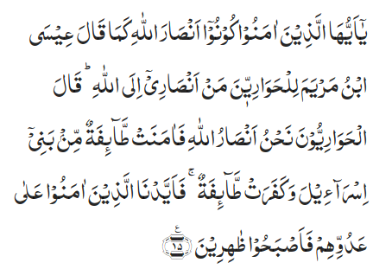
Recitation of the Holy Quran
O ye who believe! be helpers of Allah, as said Jesus, son of Mary, to his disciples, ‘Who are my helpers in the cause of Allah.’ The disciples said, ‘We are helpers of Allah.’ So, a party of the children of Israel believed, while a party disbelieved. Then We gave power to those who believed against their enemy, and they became victorious (61:15)

Slide 4
Ansar Pledge
Say this part three times:
Ash-hadu • alla ilaha • illallahu • wahdahu • la sharika lahu • wa ash-hadu • anna Muhammadan • ‘abduhu • wa rasuluh
Say this part once:
I bear witness • that there is none worthy of worship • except Allah. • He is One • (and) has no partner, • and I bear witness • that Muhammad (peace be upon him) • is His servant • and messenger.
Say this part once:
I solemnly pledge • that I shall endeavor • throughout my life • for the propagation • and consolidation • of Ahmadiyyat in Islam, • and shall stand guard • in defense of • the institution of Khilafat. • I shall not hesitate • to offer any sacrifice • in this regard. • Moreover, • I shall exhort my children • to always remain dedicated • and devoted • to Khilafat. • Insha’allah.

Slide 5
The Holy Quran Segment
Suggested Time = 10 mins
It contains verses, questions
about the verses, followed
by commentary and discussion

Slide 6
Verse Recited Earlier
O ye who believe! be helpers of Allah, as said Jesus, son of Mary, to his disciples, ‘Who are my helpers in the cause of Allah.’ The disciples said, ‘We are helpers of Allah.’ So, a party of the children of Israel believed, while a party disbelieved. Then We gave power to those who believed against their enemy, and they became victorious (61:15)

Slide 7
Understanding the Verse
Who is being addressed in this verse?
a. Jesus son of Mary (as)
b. Companions of Prophet Muhammad (saw)
c. Companions of Prophet Moses (as)
What glad tiding is mentioned in this verse?
Please discuss as to how can we benefit from this glad tiding?

Slide 8
Commentary
Companions of the Holy Prophet (pbuh).
The believers who offer sacrifices in the cause of Allah and will become helpers of the Promised Messiah (as) would in turn be helped by Allah the Almighty and will eventually be victorious.
If we believe in Allah the Almighty and have complete trust in Him, call people towards Him, we can win His pleasure and be triumphant. InshaAllah
Tarjumatul Quran: Hadhrat Khalifatul Masih IV ra

Slide 9
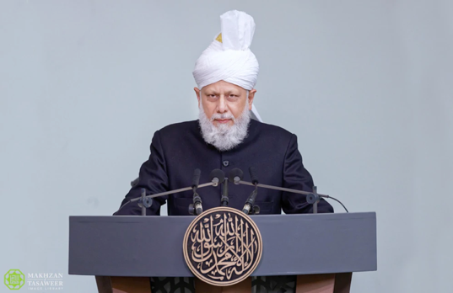
Khalifa’s guidance (aba)
Suggested Time = 20 mins
(All Ansar members need to participate in this discussion)
It contains the following items:
Scenario, question and discussion(2 slides)
Guidance from the Khalifa (1 slide)

Slide 10
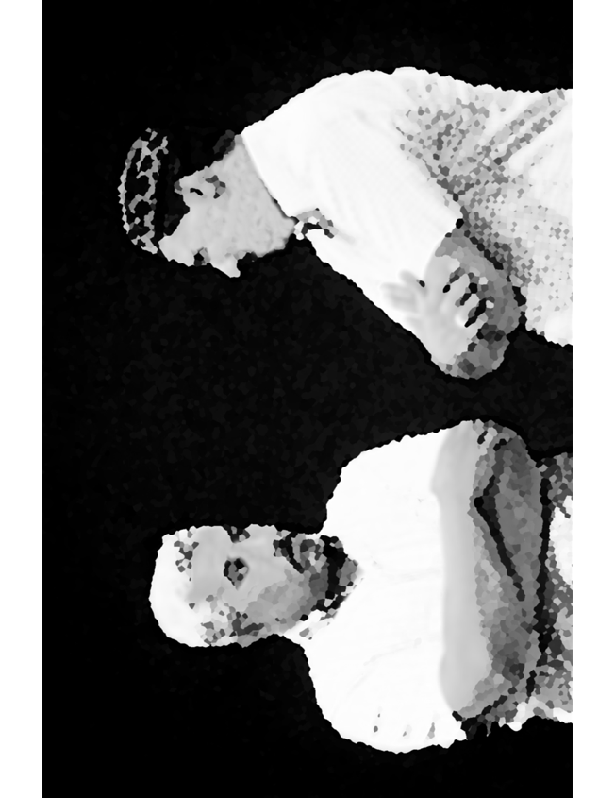
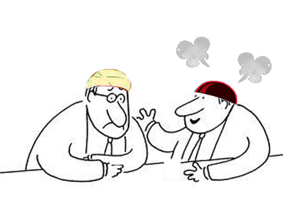
Discussion Scenario
A Za’im approached a Nasir about Ansar Chanda. The Nasir seemed visibly upset. He had just finished talking to Jama’at finance secretary. He said there is no mention of Ansar Chanda in the Holy Quran or Ahadith. Why does the Jama’at need my $100. If the Jama’at is from Allah, why do you keep asking for Chanda? Allah can support it.

Slide 11
Discussion
Why was the Nasir upset?
Does the Nasir have a point? Allah the Almighty is all powerful and can provide victory to Jama’at without our help?
How can one be called a true Nasir?

Slide 12
Nahno Anasrullah
“On one occasion the Promised Messiah (peace be upon him) said that when the prophets (peace be upon them) asked ‘Who is it that will help me in taking people towards Allah the Almighty?’ it was because it is the law of nature that to complete grand and important tasks there is the need of helpers. Such great tasks cannot be completed by just one person. Moreover, even though the Prophets manifested the highest standards of reliance and trust upon God, according to this law of nature they still also called upon helpers.”
“Therefore, you who call yourselves ‘Ansarullah’ (The helpers of God) must always keep this at the forefront of your mind that you can only truly be called ‘Ansarullah’ when you answer the call of the Imam of this Age, the appointed one of God, the Promised Messiah and Mahdi, and are not just Ansarullah by name. Rather, be those who sincerely raise slogans that ‘we are the helpers of Allah’, whilst understanding this spirit as well.”
Based on Huzoor’s address in the final session of UK Ansarullah Ijtima, 9/12/21

Slide 13
Domestic responsibility Segment
‘Every man and woman should make an effort in their prayers and in their practices to bring about positive changes in themselves and become true models of those who take bai’at. This is so that they can be counted amongst those people who are not only concerned about their own good practices but are also concerned about the welfare of their next generation for which Allah the Exalted has taught us in the prayer: ‘Our Lord, grant us of our spouses and children the delight of our eyes and make each of us a leader of the righteous.’
(25:75) 6/25/11 Address to ladies, Jalsa Germany

Slide 14
Salat Page
“In reality, Salat is but a name for plunging into a fire, and after plunging into a fire of Divine love and fear of Allah, to burn one’s being and burn everything except Allah; and it is but a name for such a state wherein God, and only God remains in sight; and man progresses to such a state wherein he speaks when God wishes, and walks when God wishes; the whole of his moving or remaining still, his performing an action or abandoning an action begins to conform to Allah’s will and the ego is annihilated.” (Malfuzat, Vol.10, pp.314)

Slide 15
Mental and Physical health Segment
Suggested Time = 15 mins
It contains questions of
general knowledge and/or
religious knowledge
followed by their answers.
A thought-provoking video and a physical health segment

Slide 16
Mental Health

Slide 17
Quiz
What is the main cause of seasons on the earth?
Speed of earth’s motion
Tilt of earth’s axis
Distance between sun and moon
Effective hand sanitizer contains at least this much alcohol?
10%
60%
100%
In 1955, Hadhrat Khalifatul Masih II (ra) wrote a letter to USA Jama’at. What was the subject matter of this letter?
Wasiyyat.
Education
Tabligh

Slide 18
Answers
Tilt of earth’s axis in relation to the sun
At least 60%
Wasiyyat

Slide 19
Physical Health
Vaccine Safety
Tanvir Ahmed
Qaid Health, Majlis Ansarullah USA

Slide 20
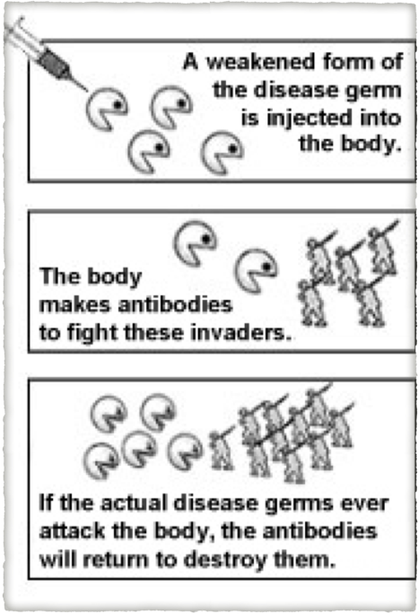
Immunization is a global health success story, saving millions of lives every year
Vaccines reduce risks of getting a disease by working with your natural immune system, creating and boosting immunity against deadly diseases

Slide 21
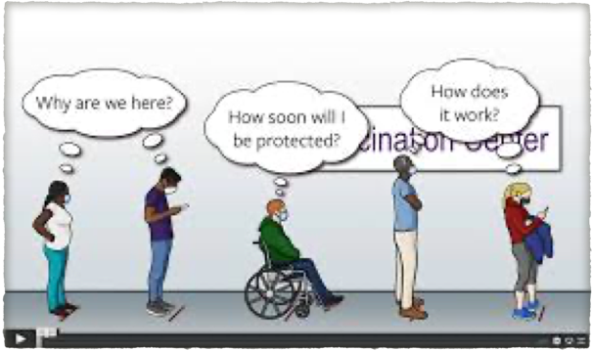
There are vaccines to prevent more than 20 life-threatening diseases so people of all ages live longer and healthier lives
Immunization currently prevents 2-3 million deaths every year from diseases like diphtheria, tetanus, pertussis, influenza and measles and even cancer. Research is underway for vaccines against AIDS, Malaria.
Vaccines are also critical to the prevention and control of infectious-disease outbreak such as COVID-19

Slide 22
VACCINE SAFETY & EFFICACY
The United States currently has the safest vaccine supply in its history
Vaccines are continuously monitored for adverse effects, efficacy and safety
Vaccines are among the safest substances developed in the human history. There are no computer chips, magnets or alien genes in vaccines !!
Adverse effects from most vaccines are mild and temporary. Serious adverse effects are rare and outweigh the universal health benefits
Many vaccines provide long term protection. Some require annual (Flu) or periodic boosters (Tetanus)
Video https://www.youtube.com/watch?v=dA7GuMQ-9F0

Slide 23
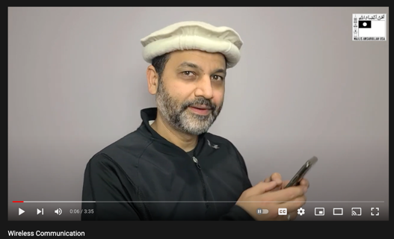
Technology Segment
How Wireless Communication Works?
Please click the YouTube video link:
https://youtu.be/DQu8aqqi-oQ

Slide 24
Take "home" message?
Pick one of the following topics from this speech to discuss with children/family during casual discussion:
How can our family become a helper of Allah?
Tips to engage youth in conversation: (1) Give them more talking time, and (2) use examples from Huzur’s (may Allah be his helper) sermon to make a point.

Slide 25
LOCAL TOPICS

Slide 26
That’s all folks
Reminders/Announcements
Dua
Jazakumullah for Participating!
If you enjoyed it, please convey to those brothers who are not here today!

