Slide 1
Majlis Ansārullāh Monthly Meeting
May 2022
This slide deck contains images licensed for the purpose of this presentation only.
No one is permitted to use the images for any other use, without prior permission.

Slide 2
Agenda
Recitation of the Holy Quran (5 mins)
Pledge
The Holy Quran segment (10 min)
Khalifa’s guidance segment: Based on Huzoor’s address in the final
session of UK Ansarullah Ijtema, 9/12/21 (20 min)
Domestic responsibility segment (10 mins)
Salat (Daily Prayers) Segment (5 mins)
Health segment (10 min)
Technology segment (5 mins)
Open slot for local topics (10-20 mins)
Reminders/announcements (5 mins)
Dua’
Suggested Total Time (75 – 90 mins)

Slide 3
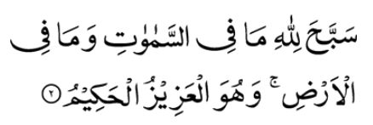
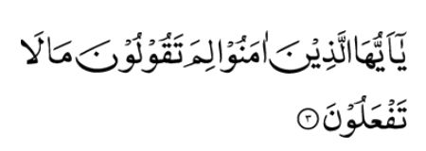
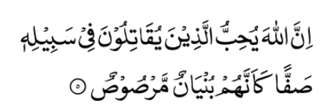
Recitation of the Holy Quran
Whatever is in the heavens and whatever is in the earth glorifies Allah; and He is the Mighty, the Wise
O ye who believe! why do you say what you do not?
Most hateful is it in the sight of Allah that you say what you do not.
Verily, Allah loves those who fight in His cause arrayed in solid ranks, as though they were a strong structure cemented with molten lead.
(61:2-5)

Slide 4
Ansar Pledge
Say this part three times:
Ash-hadu • alla ilaha • illallahu • wahdahu • la sharika lahu •
wa ash-hadu • anna Muhammadan • ‘abduhu • wa rasuluh
Say this part once:
I bear witness • that there is none worthy of worship • except Allah. • He is One • (and) has no partner, • and I bear witness • that Muhammad (peace be upon him) • is His servant • and messenger.
Say this part once:
I solemnly pledge • that I shall endeavor • throughout my life • for the propagation • and consolidation • of Ahmadiyyat in Islam, • and shall stand guard • in defense of • the institution of Khilafat. • I shall not hesitate • to offer any sacrifice • in this regard. • Moreover, • I shall exhort my children • to always remain dedicated • and devoted • to Khilafat. • Insha’allah.

Slide 5
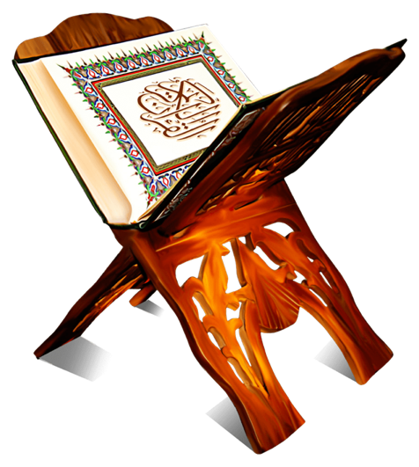
The Holy Quran Segment
Suggested Time = 10 mins
It contains verses, questions
about the verses, followed
by commentary and discussion

Slide 6
Verses Recited Earlier
Whatever is in the heavens and whatever is in the earth glorifies Allah; and He is the Mighty, the Wise
O ye who believe! why do you say what you do not?
Most hateful is it in the sight of Allah that you say what you do not.
Verily, Allah loves those who fight in His cause arrayed in solid ranks, as though they were a strong structure cemented with molten lead.
(61:2-5)

Slide 7
Understanding the verse
Commentary
How can one prove the truth of the Holy Prophet (peace and blessings of Allah be on him) based on 61:3
Despite doing Bai’at of Promised Messiah (peace be on him), can one incur wrath of Allah?

Slide 8
Commentary
Commentary
This verse teaches us a great lesson. Words do not carry much weight unless accompanied by corresponding actions. The fact that the Holy Prophet (peace and blessings of Allah be on him) was so successful and loved by his companions proves that he acted on all the advice he gave them.
The Promised Messiah (peace be on him) has repeatedly said that verbal claim of pledging allegiance does not carry much weight unless accompanied by actions in accordance with his teachings. In fact, based on 61:4, one can incur displeasure of Allah if one does not act upon the teachings of the Promised Messiah (peace be on him) after pledging allegiance to him

Slide 9
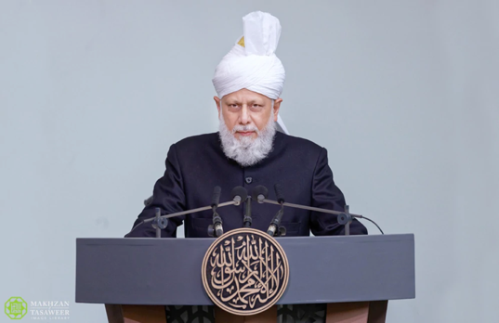
Khalifa’s guidance (aba)
Suggested Time = 20 mins
(All Ansar members need to participate in this discussion)
It contains the following items:
Scenario, question and discussion (2 slides)
Guidance from the Khalifa (1 slide)
Take home message from the speech (1 slide)

Slide 10
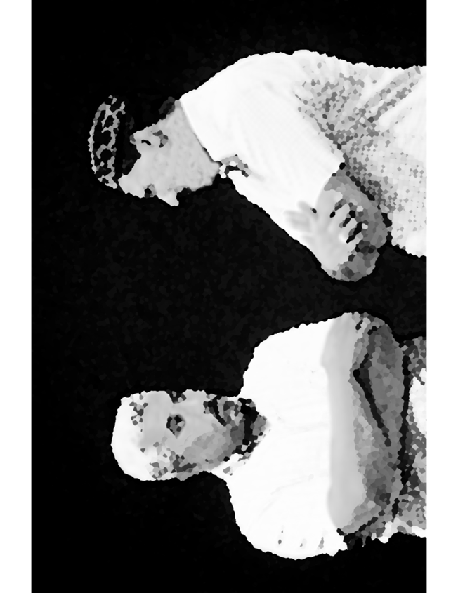
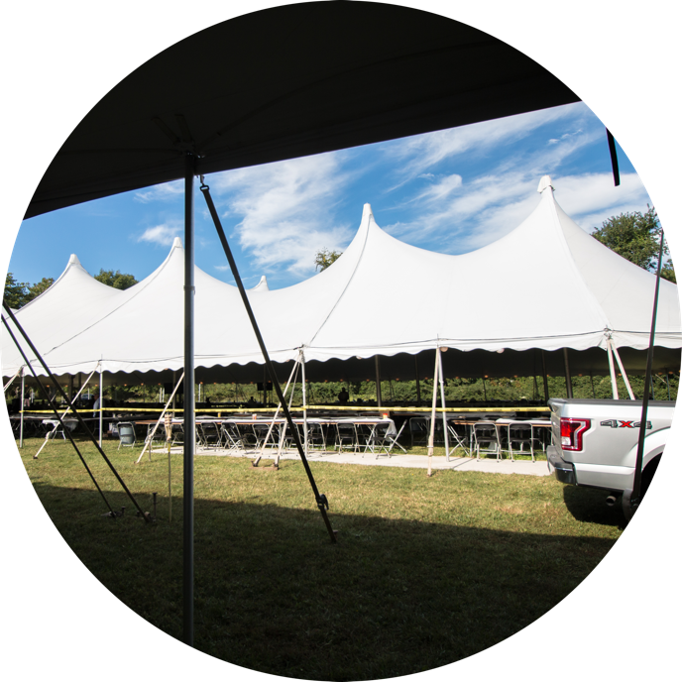
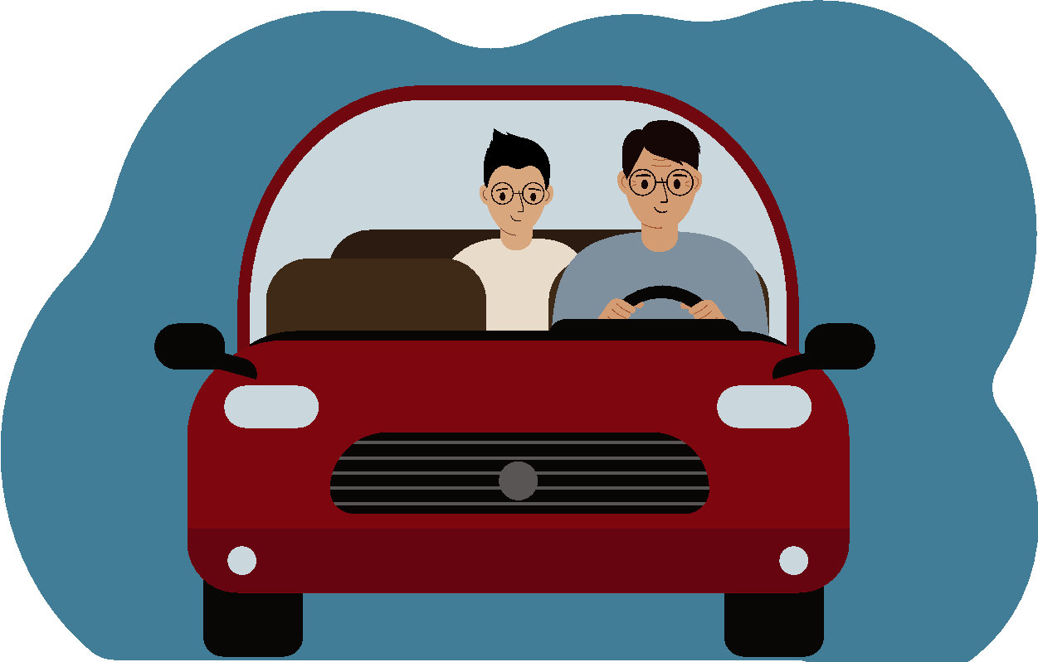
Discussion Scenario
A new convert wanted to go to Ansar Ijtema. Za’im sahib arranged for him to carpool with a group of Ansar. On the way, one of the Nasir told him that the Jama’at president has been against him and his family. He has a soft corner towards his own friends. Another Nasir shared his opinion that the president does not have a deep understanding of the system of the Jama’at. During the Ijtema they stayed with him and explained the program. They told him that the sports activities and Bar-B-Q is a lot of fun however, most of the Talim competitions are boring. Zaim sahib noticed that the convert was very quiet and subdued after the Ijtema and missed the next monthly meeting.

Slide 11
Questions
In your opinion, did the convert benefit from the Ijtema?
What do you think went wrong in this trip?

Slide 12
“Why do you say what you do not do”
“A person having stayed in the company of a Maulvi (religious cleric) and hearing his exhortations of piety and spirituality had become convinced to convert to Islam. One day the person who was due to convert came across that same cleric drinking alcohol and his heart became hardened, and he stopped. He said that this cleric tells me good and pious things and tells me about the detriment of alcohol yet he himself is sitting here drinking alcohol and so he thought to himself one should stay away from such a religion.”
“One should not just convey the message of Islam with their words, rather they should do so with their actions. They should convince others with their personal examples, by remaining steadfast and guiding others with patience. One should not become frustrated in the face of opposition. So, these two principles must always be kept in mind when conveying Islam’s teachings: to create unity in one’s actions and teachings, and secondly to act with patience, consistency and self-control.”
Based on Huzoor’s address in the final session of UK Ansarullah Ijtema, 9/12/21

Slide 13
Take "home" message?
Please review the following with children/family during casual discussion:
Analyze the qualities of a true follower of the Promised Messiah
Judge your actions in accordance with these qualities ?
Tips to engage youth in conversation: (1) Give them more talking time, and (2) use examples from Huzur’s (may Allah be his helper) sermon to make a point.

Slide 14
Domestic responsibility Segment
‘Another malady which is ruining homes and causing constant conflicts and restlessness in families is that after marriage, despite the capacity to live independently and without any warrantable reason, young men stay at their parents’ home with their siblings. If the parents are elderly and have no one to take care of them and are disabled with no helper, then it is the son’s duty to keep them with him and also serve them. However, if there are other siblings who live with the parents, then there is no harm in living separately. These days a lot of difficulties are created because of this. If living in joint family situation only increases one to commit sins, then it cannot be a virtue or a means to serve parents. (Friday sermon delivered on 10 November 2006 at Baitul Futuh, London. Published Al Fazl International 1 December 2006)

Slide 15
Salat Page
Man can never achieve nearness to Allah without practicing iqamusslat (observance of Salat). He ordered aqeemussalat (observe Prayer) because Salat tends to falter and those who comply with iqamusslat they benefit from its spiritual form. […] I have admonished my Jama’at to offer Salat decently and that too is supplication. (Malfuzat Vol. 2 p 346)

Slide 16
Mental & Physical health Segment
Suggested Time = 15 mins
It contains
Questions of general knowledge and/or religious knowledge followed by their answers.
A thought-provoking video
A physical health segment

Slide 17
Mental Health
How many breaths do humans take in a day?
24000 2. 24 3. 2400
What does Corona in Coronavirus mean?
Crown 2. Sun 3. Moon
Who are the “Dervishes” of Qadian?
Religious clerics,
Founders of the city,
Individuals asked to watch over holy sites

Slide 18
Approximately 24000
Crown
Individuals who were asked to stay in Qadian to watch over the Holy sites at the time of partition of India.

Slide 19
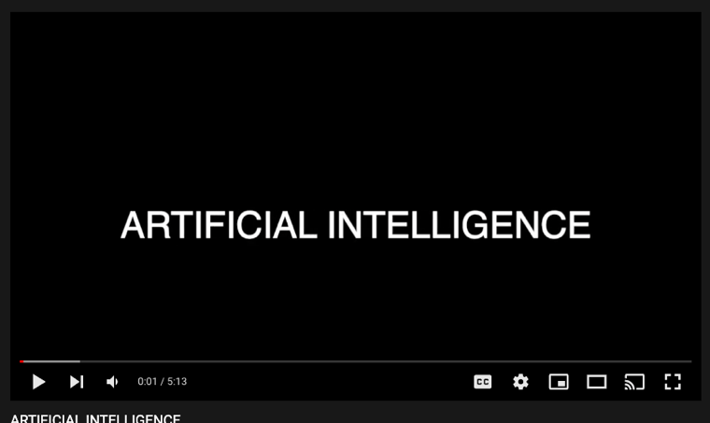
Technology Video
Answers
Link embedded within the above thumbnail,
it can be played by clicking on it in presentation mode
https://youtu.be/DOpwEDwlDuE

Slide 20
What is AI?
Combination of Computer Science principles and large datasets to solve “problems”
A “long” history:
Early stages of computer chess began in the 50s; First retail chess computer in 1977
IBM Deep Blue defeated Gary Kasparov in 1997; IBM Watson won Jeopardy Challenge 2011
Expert Systems: mimic decision-making process of humans (“rules engine”)
Today: Self-driving cars, household gadgets (Roomba vacuum), speech recognition (Siri), computer vision (Xray, CT scans, MRI), recommendation engines (shopping, videos, etc.), finance (trading), Robots (Boston Dynamics dog or Hanson Robotics’ Sophia), artwork, music
Proliferation of data and powerful computing helped drive success of AI
Big advancements in Vision and Natural Language Processing
Hype Cycle (Innovation Trigger -> Inflated Expectations -> Plateau)

Slide 21
Heart Disease in South Asians
Health talk
Answers
A Uniquely High Risk Group
https://www.mayoclinic.org/diseases-conditions/heart-disease/in-depth/heart-disease-prevention/art-20046502
South Asians men (Pakistan India, Bangladesh and other countries in the region) are identified as a uniquely high risk group for heart disease and have 4x greater risk of heart disease than general population and a much greater chance of heart attack before age 50
Heart attack strike south Asians (men and women) at a younger age and is deadlier than the general population. Almost one in three in this group will die from heart disease before age 65.

Slide 22
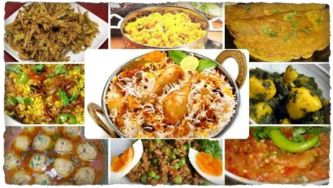
Smoking and Diet
Thin Fat Syndrome
Body mass index (BMI) in South Asians often falls into a Thin-fat syndrome
People have a normal BMI (25 or less), but carry more weight in their abdomen and that visceral fat is more likely to lead to a Heart Attack etc.
South Asians tend to be smokers
Typical South-Asian diet is high in sugar, refined grains, and fatty foods
Weight Training builds muscles, improves joint stability and mobility
Start low and go slow and exercise different muscle groups each day
Exercise different group of muscles every day

Slide 23
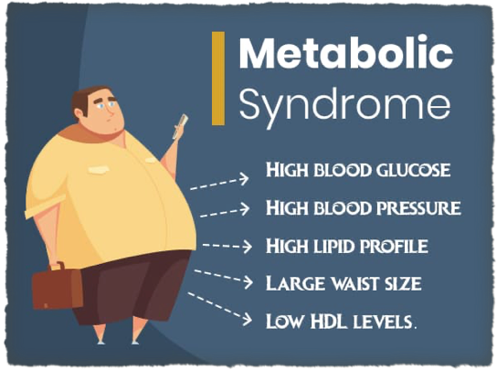
The Metabolic Syndrome
More than 1/3rd of South Asian men and 17% of South Asian women have metabolic syndrome which predisposes to heart disease
If more than one of these conditions occur in combination, the risk is even greater for heart disease

Slide 24
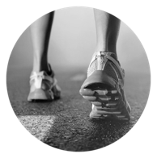
Strategies to prevent heart disease
Knowledge is Power; be aware of your risks talk to your doctor
Don't smoke or use tobacco
Get moving: exercise at least 30-60 minutes of activity daily
Eat a heart-healthy diet
Maintain a healthy weight
Get good quality sleep - Internet at night is not heart heathy
Manage stress
Talk to your doctor and get regular health screening
email qaid.health@ansarusa.org for any questions

Slide 25
LOCAL TOPICS

Slide 26
That’s all folks
Reminders/Announcements
Dua
Jazakumullah for Participating!
If you enjoyed it, please convey to those brothers who are not here today!

