Slide 1
Majlis Ansārullāh Monthly Meeting
January 2023
This slide deck contains images licensed for the purpose of this presentation only.
No one is permitted to use the images for any other use, without prior permission.

Slide 2
Agenda
Recitation of the Holy Quran (5 mins)
Pledge
The Holy Quran segment (10 min)
Hadith (5min)
Khalifa’s (aba) guidance segment: (20 min)
Al-Wasiyyat (5 mins)
Salat (Daily Prayers) Segment (5 mins)
Health segment (10 min)
Open slot for local topics and/or interactive discussion with Murabbi sahib (10-20 mins)
Reminders/announcements (5 mins)
Dua'
Suggested Total Time (75 – 90 mins)

Slide 3
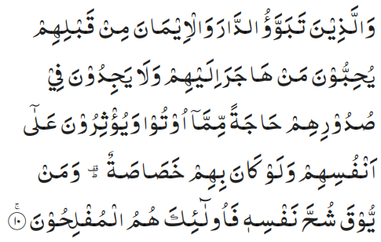
Recitation of the Holy Quran
And for those who had established their home in this city and had accepted the faith before them, they love those who come to them for refuge, and find not in their breasts any desire for that which is given them (Refugees), but prefer the Refugees alone themselves, even though poverty be their own lot. And whoso is rid of the covetousness of his own soul—it is these who will be successful (59:10)

Slide 4
Ansar Pledge
Say this part three times:
Ash-hadu • alla ilaha • illallahu • wahdahu • la sharika lahu • wa ash-hadu • anna Muhammadan • ‘abduhu • wa rasuluh
Say this part once:
I bear witness • that there is none worthy of worship • except Allah. • He is One • (and) has no partner, • and I bear witness • that Muhammad (peace be upon him) • is His servant • and messenger.
Say this part once:
I solemnly pledge • that I shall endeavor • throughout my life • for the propagation • and consolidation • of Ahmadiyyat in Islam, • and shall stand guard • in defense of • the institution of Khilafat. • I shall not hesitate • to offer any sacrifice • in this regard. • Moreover, • I shall exhort my children • to always remain dedicated • and devoted • to Khilafat. • Insha’allah.

Slide 5
The Holy Quran Segment
Suggested Time = 10 mins
It contains verses, questions
about the verses, followed
by commentary and discussion

Slide 6
Recitation of the Holy Quran
And for those who had established their home in this city and had accepted the faith before them, they love those who come to them for refuge, and find not in their breasts any desire for that which is given them (Refugees), but prefer the Refugees alone themselves, even though poverty be their own lot. And whoso is rid of the covetousness of his own soul—it is these who will be successful (59:10)

Slide 7
Understanding the Verse
This verse is mentioning which two groups of individuals?
This verse is alluding to which event in the history of Islam?
How can we apply the example given in this verse to our daily lives?

Slide 8
Commentary
The Ansar (residents of Medina) and the Muhajireen (refugees from Mecca).
Allah the Almighty is alluding to the great act of brotherhood between the Ansar of Medina and the Muhajireen from Mecca. The Holy Prophet (peace and blessings of Allah be on him) joined them in a historic connection of Muslim brotherhood
The acts of kindness and sacrifice showed by the Ansar of Medina is an example for us to follow. We must treat new brothers in our Jama’at with the same acts of kindness and sacrifice.
Five volume commentary

Slide 9
Hadith
“O Allah, bless Muhammad and prosper him and grant him peace; Thou art Praiseworthy and Glorious”
"You can never enrich people with your money alone; so, help them cheerfully and with good grace." (Risalah Qushariyyah)

Slide 10
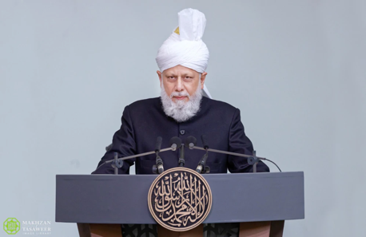
Khalifa’s guidance (may Allah be his helper)
Suggested Time = 20 mins
(All Ansar members need to participate in this discussion)
It contains the following items:
Scenario, question and discussion(2 slides)
Guidance from the Khalifa (1 slide)

Slide 11
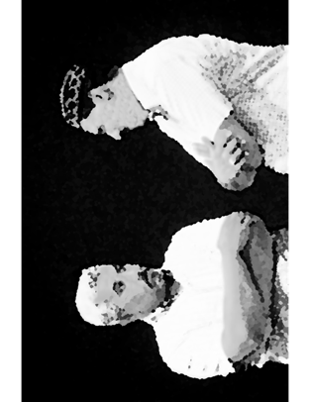
Discussion Scenario
Discussion Scenario
The first Ansar meeting of the year was taking place. Zai’m sahib was very happy as the attendance was better than usual. In his opening comments, he remarked that the Majlis is now larger due to the presence of several refugees. Many of the refugees are present in the meeting. He turned towards Muntazim Ithar and asked him to make sure the Majlis conducts a clothing drive soon to help the refugees.

Slide 12
Discussion
Do you have any concerns about Zaim sahib’s approach?
How would you have dealt with the circumstances?
What can you do to improve brotherhood in the Majlis?

Slide 13
Khalifa’s (aba)guidance 1 of 2
“Always keep Allah’s commandment in mind to only give for the sake of Allah what you like for yourself. Not like some who help their needy brother while bragging about it. Some have such strange nature that they gift out of there consumed items and used clothes. Such people should have regard for the dignity of their brothers and sisters. It will be better not to gift if they can’t afford it. Alternatively, they should disclose that this a used item and I will offer if you are willing to accept. Some write to me that they want to gift nice clothing’s for the wedding of poor girls which have been used only once or twice and are now small or can’t be used for some other reasons”. (contd. Next slide)

Slide 14
Khalifa’s (aba) guidance 2 of 2
“It should be clear that whether such items are being donated under the auxiliaries, Lajna or Khuddam-ul-Ahmadiyya or individually, the dignity of the poor should be kept in mind. Items should only be given if they are worth sharing. Not ones which are worn, smelly, stained and not usable. There is a self-esteem of the poor which must be considered and if clothes are to be given, they should clean, washed, and restored first. As I have stated before, if the auxiliaries are donating clothes, they must clearly mention that they are used and should be accepted willingly. Everyone has a self-esteem and as I have stated, it should be highly regarded and cared for”. (FS 9/12/2003)

Slide 15
Al-Wasiyyat (The Will)
“But when I depart, God will send that second Manifestation for you which shall always stay with you just as promised by God in Brahin-e-Ahmadiyya. And this promise is not for my person. Rather the promise is with reference to you, as God [addressing me] says: I shall make this Jama‘at who are your followers, prevail over others till the Day of Judgment”.
Questions for self reflection
Have you joined the system of Wasiyyat? If not, are you comfortable with your reasoning?
If you are a Moosi, are you satisfied with the spiritual purification expected of you?

Slide 16
Salat Page
I wish to draw the attention of the ansar to an extremely important but fundamental matter. And that is salat [prayer]. Salat is obligatory upon every believer. However, after the age of 40, one should have developed an increased sense of awareness [of the fact] that with the passing of each day, one's life is decreasing. Thus, every believer; everyone, who believes in the life after death and the Last Day, should be fully focused on fulfilling the rights of Allah the Almighty as well as the rights of His servants. (Friday Sermon 9/29/2017)

Slide 17
Mental and Physical health Segment
Suggested Time = 15 mins
It contains questions of
general knowledge and/or
religious knowledge
followed by their answers.
A thought-provoking video and a physical health segment

Slide 18
Mental Health

Slide 19
Quiz
What is the common name for dried plums?
Who created the character Sherlock Holmes?
What is the purpose of the scheme of Waqfe Jadid?

Slide 20
Answers
Dried plums are called prunes. There are several different types of prunes available. One ounce of prunes contains 67 calories and two grams of fiber. They contain several vitamins and minerals. They relieve constipation and act as natural laxative
Sherlock Holmes is a fictional detective of the late 19th and early 20th centuries, who first appeared in publication in 1887. He was devised by British author and physician Sir Arthur Conan Doyle.
The aim of this scheme is to provide education and training to rural Jama‘ats, as well as to take the message of Tauhid to idol worshippers

Slide 21
Water
Tanvir Ahmed

Slide 22
Water makes 50-70% of your body weight
According to Mayo Clinic, an adequate daily amount for men is 3.7 liters and 2.7 liters for women

Slide 23
You will need more water in hot environment or with increased physical activity
The average length of time a human can survive without water is 3 days

Slide 24
Stay Hydrated
According to CDC, there are quite a few benefits from staying properly hydrated
Maintain normal body temperature
Prevention of constipation
Prevention of Kidney stones
Help Lubricate Joints
Protection of spinal cord and other sensitive tissues

Slide 25
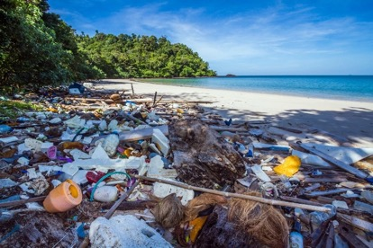
Ditch your Plastic Water Bottle
Study Shows That Bottled Water Is 3,500 Times More Harmful to the Environment Than Tap Water
Single Use Plastic is one of the biggest danger to marine life
Bottled water is NOT FRESH
It is very expensive

Slide 26
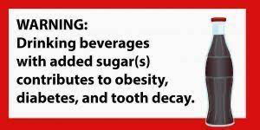
Is Soda or Gatorade
better than Water
Carbonated and Sugary drinks have no health benefits
In fact the harm comes from very large amounts of sugars in these drinks

Slide 27
Rethink What you Drink
They are extremely expensive
Many contain artificial sweeteners which are controversial at times and may actually result in harm long term

Slide 28
LOCAL TOPICS

Slide 29
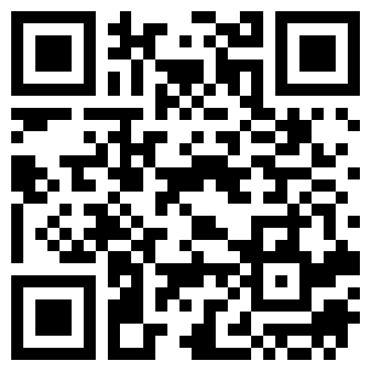
That’s all folks
Reminders/Announcements
Dua'
Jazakumullah for Participating!
If you enjoyed it, please convey to those brothers who are not here today!
Please provide feedback so we can do better
https://forms.gle/B17grkrjVNq5zCJR8

