Slide 1
Majlis Ansārullāh
Monthly Meeting
January 2025
Freedom or Bondage
Staying connected with Allah frees us from the shackles of Satan

Slide 2
AGENDA
Recitation and translation of the Holy Quran
Pledge
Hadith
Discussion Segment
Salat (Daily Prayers)
Al–Wasiyyat
Zahanat
Reading The Holy Quran
Health segment
Local Time – Missionary Comments/Reminders/Announcements
Du’a

Slide 3
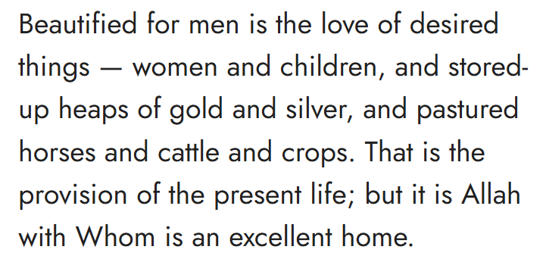
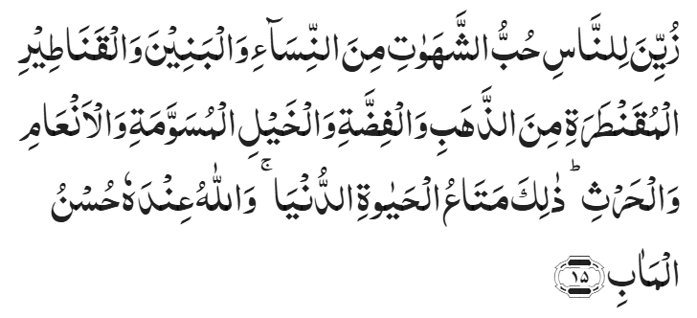
Recitation of the Holy Quran
Chapter 3, Aal-e-Imran, Verse 15

Slide 4
Pledge
Say this part three times:
Ash-hadu • alla ilaha • illallahu • wahdahu • la sharika lahu • wa ash-hadu • anna Muhammadan • ‘abduhu • wa rasuluh
Say this part once:
I bear witness • that there is none worthy of worship • except Allah. • He is One • (and) has no partner, • and I bear witness • that Muhammad (peace be upon him) • is His servant • and messenger.
Say this part once:
I solemnly promise that • I shall endeavor • till the end of my life • for the consolidation • and propagation of Islām Ahmadiyyat • and for upholding • the institution of Khilafat. • I shall also be prepared • to offer the greatest sacrifice • for this cause. • Moreover, • I shall urge all my children • to remain true • to Khilafat Ahmadiyya. • Insha’Allah.

Slide 5
Hadith

Slide 6
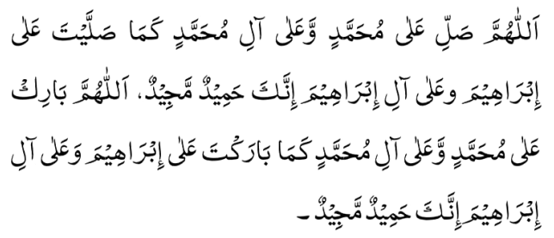
Hadith
O Allah, Bless Muhammad^{sa} and the people of Muhammad^{sa}, as Thou didst bless Abraham and the people of Abraham. Thou art indeed the Praiseworthy, the Glorious. Prosper, O Allah, Muhammad^{sa} and the people of Muhammad^{sa}, as Thou didst prosper Abraham and the people of Abraham. Thou are the Praiseworthy, the Glorious
Hadrat Abu Huraira^{ra} reported Holy Prophet^{saw} as saying: Of the dinar you spend as a contribution in Allah's path, or to set free a slave, or as a sadaqa given to a needy, or to support your family, the one yielding the greatest reward is that which you spent on your family.
Sahih Muslim Hadith 48

Slide 7
The Holy Quran Discussion

Slide 8
Recitation of the Holy Quran
Chapter 3, Aal-e-Imran, Verse 15

Slide 9
Discussion
In a question answer session at a Jama’at meeting, there were several questions about contemporary issues such as homosexuality, transgenderism etc. Murabbi sahib was trying to answer questions with references from the Holy Quran. One guest complained about his approach. He raised the point that many Islamic teachings are from seventh century Arabia. The world has moved on and there are many advances in the society. Muslims need to adopt to new liberal values and stay with the rest of the society to enjoy life. They need to focus more on humanity and respect everyone’s freedom of choice. Religion is a personal matter and need not interfere with the freedoms and advancements in the society.
Do you agree with his question?
How would you respond?

Slide 10
Five Volume Commentary
The verse enumerates some of the things of this world which engross man’s attention and often turn him away from God. These are particularly the things to the acquisition of which men, more specially in Christian countries, have applied their time and energy. As already pointed out, it is the Christians that are chiefly addressed in this Surah. Islam does not prohibit the use, or even the seeking, of the good things of this world; but it certainly condemns the action of those who become engrossed in them and make them the very object of their life. Elsewhere the Quran refers to the Christian people as "those whose efforts are all lost in the life of this world" (18:105).
As to the question, who is the "beautifier" referred to in the clause, beautified for men, it may be noted that though the natural beauty in all things comes from God, yet here the "beautifier" is Satan, for in the present verse the question is not of "simple beauty" but of "engrossing beauty", not simply of the desired things of the world but of the abnormal love for them; and it is certainly Satan who endows the things of this world with engrossing beauty and creates in the hearts of men special love for them. God is only the Beautifier of good deeds and good things, and the Creator, in the heart of man, of dislike for evil ones (49:8, also 16:64).

Slide 11
HKM IV^{ra} Review of Religions January 1994
The fact is that the pursuit of pleasure and a sense of liberty coupled together have made western society what it is today. Liberty from what? Liberty from all bondage that binds man to his Creator. This is what I see in the western concept of liberty today. Liberty from all that is noble that creates responsibility, which binds you and which limit your avenues of pleasure seeking. That is the liberty which the West has got today and is still pursuing – a mad pursuit of pleasure wherever it is to be had, forgetting that it is not for man to get whatever he wants to whatever extent he wants to have it.
The only way of improving a society is by bringing that society closer to God because God belongs to all people of every color, shade and hue. So those who belong to Allah have compassion for! all men. They don’t discriminate between white and black, between Northern and Southern, between Western and Eastern because they belong to God. So, the only way to cultivate humanity is to turn to God. This is my message to you – do it now as soon as possible! I see already a losing battle in the few days I have been in Australia. I have not lost hope, because it is not for man to lose hope as long as one can pray, as long as Allah can listen to us with mercy, we cannot lose hope at all, but things in a very bad shape, to say the least.

Slide 12
Speech by Hazrat Khalifatul Masih V^{aba}
Majlis Ansarullah UK Annual Ijtima 2024
“We are living in a time where excesses are being normalized under the guise of ‘progress’ and ‘freedom’. In such an environment, Ansarullah’s responsibilities are increased significantly because Ansarullah is the organization consisting of those members of the Community who have reached the age of maturity. Therefore, it is their duty to set a positive example for other Ahmadi Muslims.”
“Seek to act according to the expectations of the Promised Messiah^{as} to whom we have pledged our allegiance. We need to create an environment in our homes that sets forth a pure and righteous example. Be an example and role model for your wives and children in such a manner that they look up to you. These examples must also be set for the wider communities and surroundings, showing the way towards goodness.”

Slide 13
Salat

Slide 14
Salat
The Promised Messiah^{as} has repeatedly and at numerous occasions, drawn our attention towards the subject of prayer and it being binding, its wisdom, the method it should be performed and the philosophy behind prayer and its timings. In one gathering, the Promised Messiah^{as} explained why prayers must be offered regularly and punctually, by saying: 'Offer your prayers with proper regularity. There are some who only offer one of the prayers. They should remember that prayers are not exempt and this even applies to the Messengers. It is narrated in a Hadith that a new group visited the Prophet who wanted concession for the prayers. The Holy Prophet^{saw} replied that a religion without actions is a worthless religion. Therefore, remember this point thoroughly and fashion your actions according to the commands of Allah the Almighty. .. However, if the Will of Allah the Almighty is present, then anything can be completely transformed aright. To achieve this, it is necessary to develop a relationship with Allah the Almighty. The best way for this is worship and in worship it is to offer the Namaz.
Friday Sermon delivered by Hazrat Khalifatul Masih V^{aba}, September 29, 2017

Slide 15
Salat
ایک موقع پر حضرت مسیح موعود علیہ الصلوٰۃ والسلام نے مجلس میں فرمایا کہ:
’’نمازوں کو باقاعدہ التزام سے پڑھو‘‘۔ فرمایا کہ’’بعض لوگ صرف ایک ہی وقت کی نماز پڑھ لیتے ہیں۔ وہ یاد رکھیں کہ نمازیں معاف نہیں ہوتیں یہاں تک کہ پیغمبروں تک کو معاف نہیں ہوئیں۔ ایک حدیث میں آیا ہے کہ رسول اللہ صلی اللہ علیہ وسلم کے پاس ایک نئی جماعت آئی۔ انہوں نے نماز کی معافی چاہی۔ آپ (صلی اللہ علیہ وسلم) نے فرمایا کہ جس مذہب میں عمل نہیں وہ مذہب کچھ نہیں۔ اس لئے اس بات کو خوب یاد رکھو اور اللہ تعالیٰ کے احکام کے مطابق اپنے عمل کر لو‘‘۔ فرمایا کہ’’اللہ تعالیٰ فرماتا ہے کہ اللہ تعالیٰ کے نشانوں میں سے ایک یہ بھی نشان ہے کہ آسمان اور زمین اس کے امر سے قائم رہ سکتے ہیں۔‘‘ اگر اللہ تعالیٰ کی مرضی ہو تو تبھی زمین و آسمان قائم ہیں ورنہ نہیں۔ فرمایا کہ ’’بعض دفعہ وہ لوگ جن کی طبائع طبیعیات کی طرف مائل ہیں کہا کرتے ہیں کہ نیچری مذہب قابلِ اِتّباع ہے کیونکہ اگر حفظ صحت کے اصولوں پر عمل نہ کیا جائے تو تقویٰ اور طہارت سے کیا فائدہ ہو گا‘‘؟ (اپنے اپنے فلسفے لوگوں نے گھڑے ہوئے ہیں۔) آپ فرماتے ہیں کہ’’سو واضح رہے کہ اللہ تعالیٰ کے نشانوں میں سے یہ بھی ایک نشان ہے کہ بعض وقت ادویات بیکار رہ جاتی ہیں اور حفظ صحت کے اسباب بھی کسی کام نہیں آ سکتے۔ نہ دوا کام آ سکتی ہے، نہ طبیبِ حاذق۔ لیکن اگر اللہ تعالیٰ کا امَر ہو تو الٹا سیدھا ہو جایا کرتا ہے‘‘۔
(ملفوظات جلد 1صفحہ 263۔ ایڈیشن 1985ء مطبوعہ انگلستان)
خطبہ جمعہ 29؍ ستمبر 2017ءفرمودہ حضرت مرزا مسرور احمد، خلیفۃ المسیح الخامس ایدہ اللہ تعالیٰ بنصرہ العزیز

Slide 16
Al-Wasiyyat

Slide 17
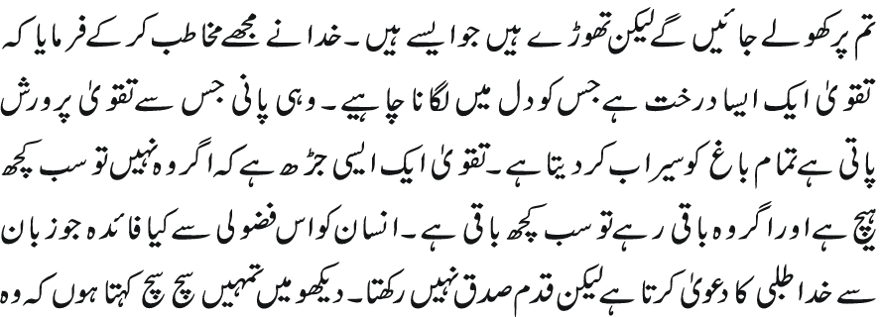
Al Wasiyyat
Al Wasiyyat
God addressed me and said that Taqwa is a tree that should be planted in the heart. The very water which nourishes Taqwa irrigates the whole garden. Taqwa is a root without which everything is meaningless; and if it remains intact then nothing is lost. What benefit is there for a man in indulging himself in the useless activity of claiming with his tongue that he seeks God while he has no sure footing with his Lord. Look, I say to you truly and sincerely that ruined is he whose faith is tainted by even a hint of worldliness. Hell is very close to that soul all of whose intentions are not for God—rather some of them are for God and others are for the world. Thus if you have an iota of worldly adulteration in your intentions, all your worship is in vain.

Slide 18
Zahanat
(Mental ability)

Slide 19
Zahanat
Q. What is acrophobia a fear of?
Clowns
Rats
Heights
Artificial Intelligence
Q. Lady Alice and Envy are varieties of what fruit?
Mangoes
Bananas
Apples
Strawberries
Q. What height is a regulation NBA basketball hoop?
12 feet
11.5 feet
10 feet
8 feet

Slide 20
Zahanat
Acrophobia
People with acrophobia have an intense fear of situations that involve heights such as being in a tall building or using a ladder. Like other specific phobias, acrophobia is treatable with a psychological therapy called exposure therapy.
Q. What is acrophobia a fear of?
Clowns
Rats
Heights
Artificial Intelligence
Q. Lady Alice and Envy are varieties of what fruit?
Mangoes
Bananas
Apples
Strawberries
Apple Varieties
Envy – an apple that’s mostly red with yellow specks.
Lady Alice – pink-blush apples that keep their shape long after being cut.
Q. What height is a regulation NBA basketball hoop?
12 feet
11.5 feet
10 feet
8 feet
Regulation Basketball Hoop
Regulation basketball hoops used throughout America have a standard height of 10 feet (3.05 meters) from the ground.

Slide 21
Reading of the Holy Quran

Slide 22
Quran Tajweed Basics Long Vowels( Ishbaiyya)
Ishbaiyya refers to stretching. It is symbolized by vertical Fat’hah , vertical Kasrah and inverted Dammah . For all three symbols, the bearing letter should be elongated for approx. two seconds or two counts.
Play Audio
Or Click here

Slide 23
Health

Slide 24
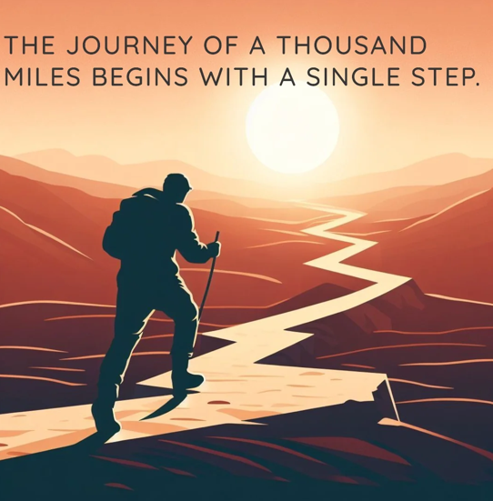
New Year Resolution Health & Happiness
Please contact Qaid Health to start a Bike Club, GYM and other clubs in your majlis Email: qaid.health@ansarusa.org

Slide 25
Resolution is defined as a firm decision to do or not to do something
Make a firm decision to achieve your goals
Make Practical Changes in your life
Work hard and pray hard to achieve your goals

Slide 26
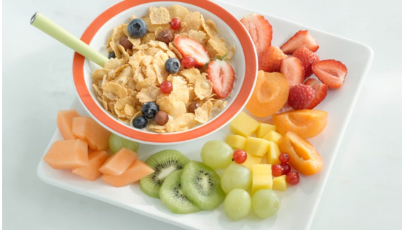
Achieve and Maintain Healthy Body Weight
A single goal for almost 70% of Americans is to reach ideal weight
One of the biggest mistake is to skip breakfast
Breakfast Skippers in fact GAIN WEIGHT when they are trying to lose weight
A balanced breakfast can consist of fruits (smoothies) boiled egg, milk or yogurt and whole wheat bread. Avoid simple sugars such as fruit juices, white bread, jams/jellies etc.
Here are some healthy recipes https://www.aicr.org/cancer-prevention/recipes/category/breakfast/

Slide 27
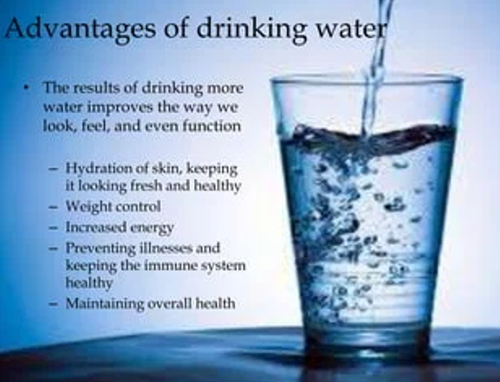
Hydrate with water
Many Americans opt to quench their thirst with sodas, juices and sports drinks instead of water
Increasing your water consumption will in fact decrease needless intake of unhealthy calories , improve your hydration and help you reach ideal body weight.

Slide 28
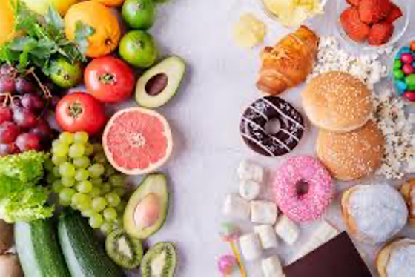
Sugars are Sweet Killers
Too much added sugar is one of the greatest threats to cardiovascular disease (heart disease, stroke etc.)
Excess Sugars can lead to Metabolic Syndrome
Metabolic Syndrome is linked to Diabetes, heart disease, elevated cholesterol and widespread inflammation
High sugar is also linked to negative effect on cognition as well as hyperactivity and in attention seen in children and adolescence

Slide 29
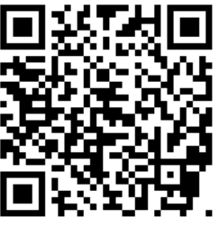
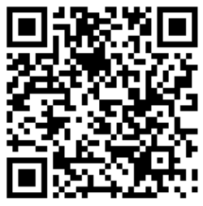
Local Majlis Time
Sign-up for TAQWA Quran classes via the following link https://www.altaqwa.us/registration/
Sign-up for Waqf e Ardhi via the following link https://tinyurl.com/WaqfeArdhiSignup
Murabbi Sahib’s Comments
Reminders/announcements
Du’a
Adjourn
Waqf e Ardhi Sign-up
Jazakumullah for Participating!
If you enjoyed it, please convey to those brothers who are not here today!
Please take a moment to provide your feedback
https://tinyurl.com/TalimDeckFeedback
Feedback

